Slide 1
Unusual laptops Svetlichnaya Alina Shabanova Anastasia

Slide 2
Quotes of the great
I don't trust a computer that I can't lift − Steve Jobs

Slide 3
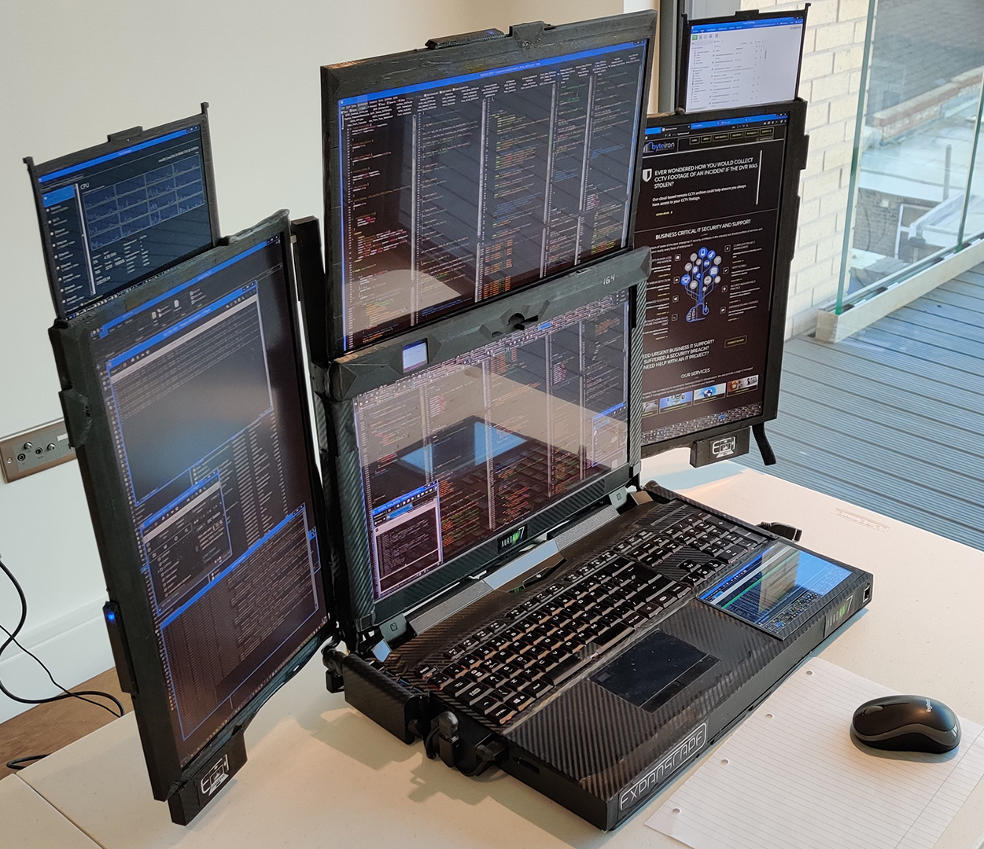
Aurora 7
The laptop is based on the AMD Ryzen 9 3950x processor. It is a 16-core chip with 32 threads support, a base clock of 3.5 GHz to a peak of 4.7 GHz, and 14 MB of L3 cache. TDP 105W, the processor itself is not new – AMD introduced it back in the fall of 2019. It is produced according to the 7nm TSMC manufacturing process.

Slide 4
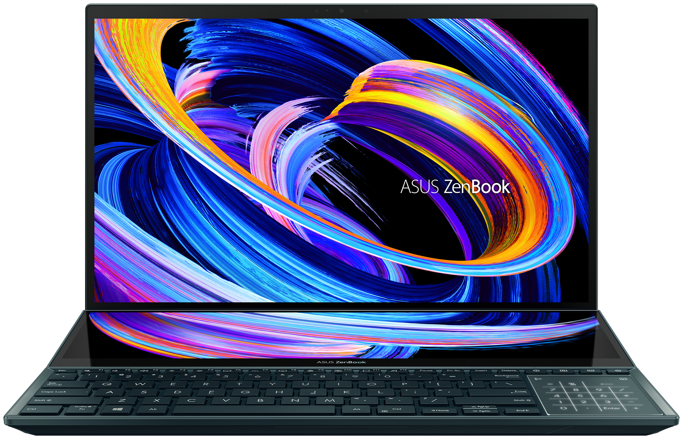
Asus ZenBook Pro Duo
Characteristic
Intel Core i9 10980HK 2400 MHz processor
RAM – 32GB DDR4
Video chip – NVIDIA GeForce RTX 2060 (6 GB)
Wireless – Wi-Fi IEEE 802.11ax, Bluetooth 5.0
Ports – USB 3.2 Gen2 Type A x 2, HDMI out, Thunderbolt 3, Mic / Headphones Combo

Slide 5
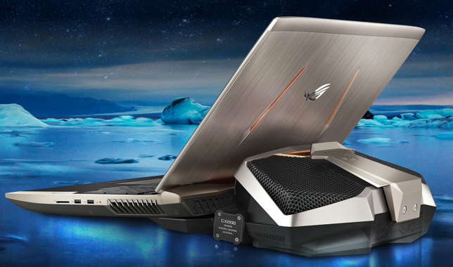
01
02
03
Screen
Processor
RAM
04
05
Storage
Video
Asus ROG GX800
18.4 “IPS (3840×2160) Ultra HD 4K, matte
Intel Core i7-7820HK (2.9 – 3.9 GHz)
64 GB
SSD 1.5TB (3 x 512GB)
nVidia GeForce GTX 1080 SLI 16GB

Slide 6
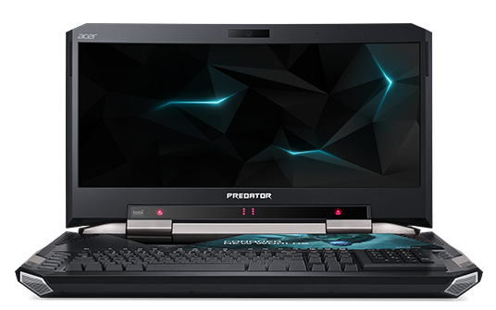
Acer Predator 21 X
Processor – Core i7-7820HK, Video – GeForce GTX 1080, RAM – 64GB DDR 4, Storage – 1TB SSD and 1TB hard drive

Slide 7
Thank you
for attention

